Slide 1
Course5i
Team : Anshika, Navin, Muskan, Vaishnavi, Varun, Saranya

Slide 2
This analysis focuses on the application of simple statistical values for the diagnostics of ball bearing.They are statistical time-domain parameters used in signal processing. We will be analysing complete lifetime of a set of four bearings they were run to failure under constant load and running conditions and detect an incipient fault on different parts of a ball bearing.

Slide 3
Data Pipeline
Part 1
Data extraction and pre-processing, we have extracted time domain features from the given acceleration data and saved them in a CSV file.
Part2
Data is visualized and fault-labels are created to convert this problem as a classification task.
Part 3
Modelling : dimensionality reduction technique, more specifically pca is used to visualize and better understand the data in a 2d and 3d space. Later, random forests used for classification and regression
Data Extraction
Data Pre-Processing
Data–Visualization
Data–Modeling

Slide 4
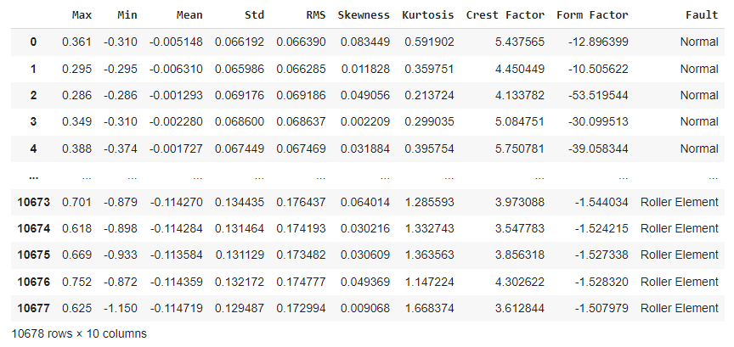
Final Dataset

Slide 5
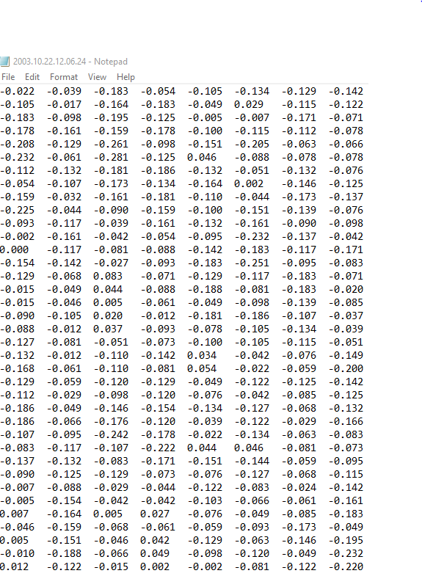
Test 1 Dataset

Slide 6
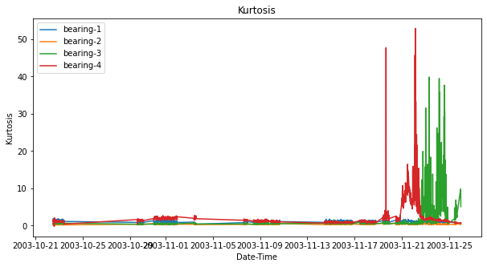
TEST-1 (Statistical analysis for Kurtosis)

Slide 7
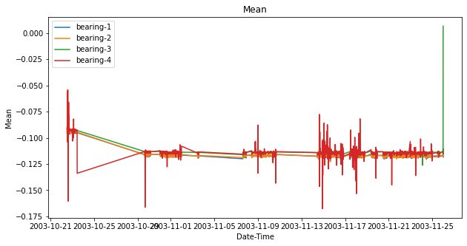
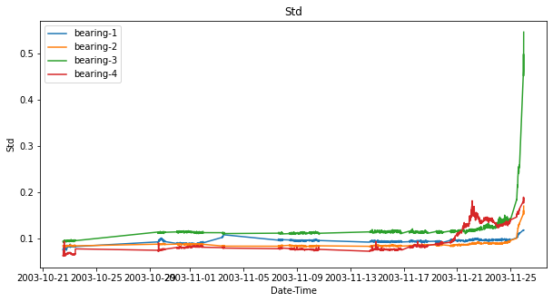
TEST-1 (Statistical analysis for mean and standard deviation)

Slide 8
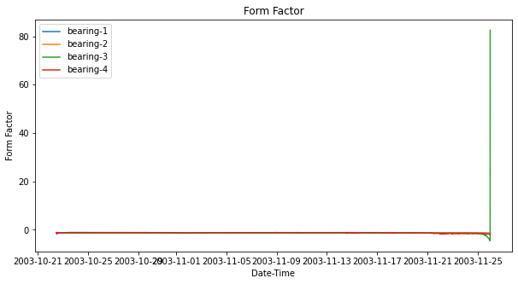
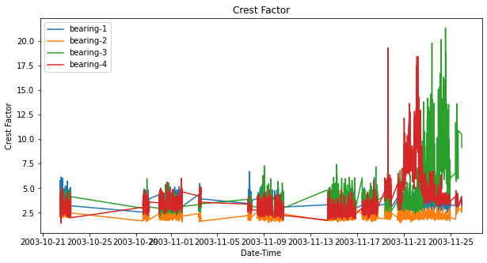
TEST-1 (Statistical analysis for Form and Crest factor)

Slide 9
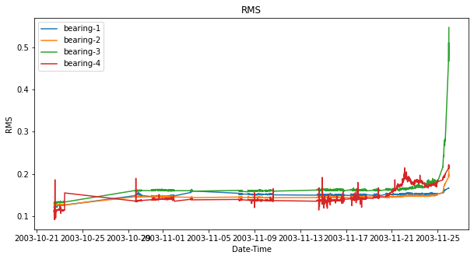
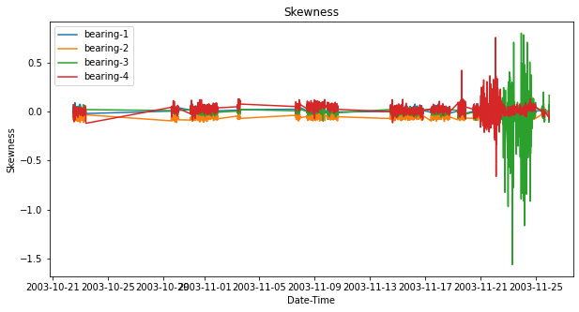
TEST-1 (Statistical analysis for rms and skewness)

Slide 10
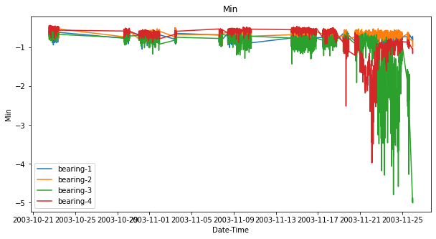
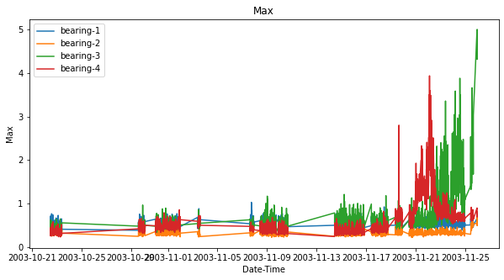
TEST-1 (Statistical analysis for min and max values)

Slide 11
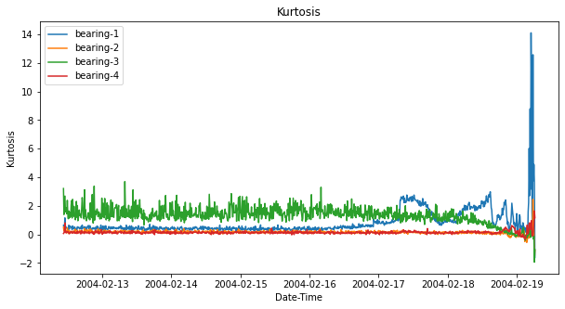
TEST-2 (Statistical analysis for Kurtosis)

Slide 12
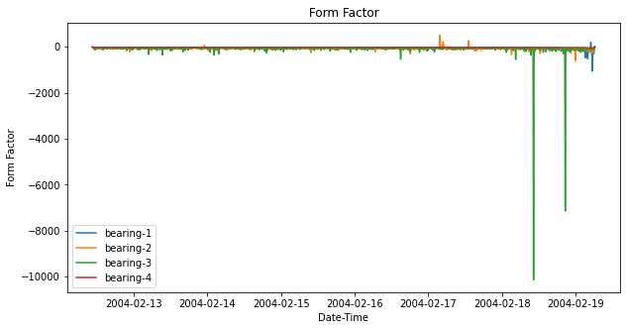
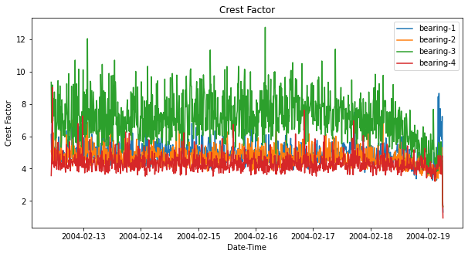
TEST-2 (Statistical analysis for Form and Crest factor)

Slide 13
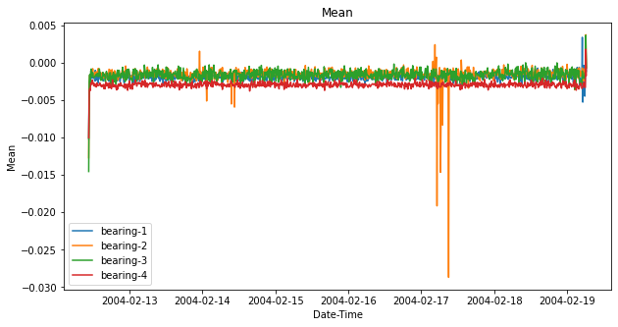
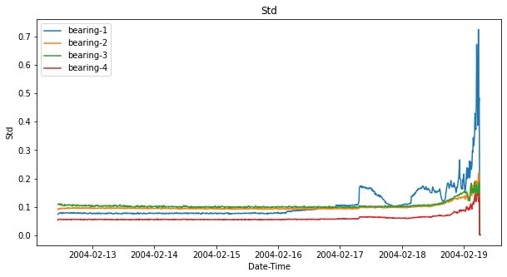
TEST-2 (Statistical analysis for mean and standard deviation)

Slide 14
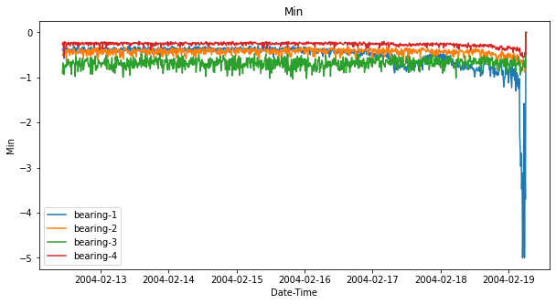
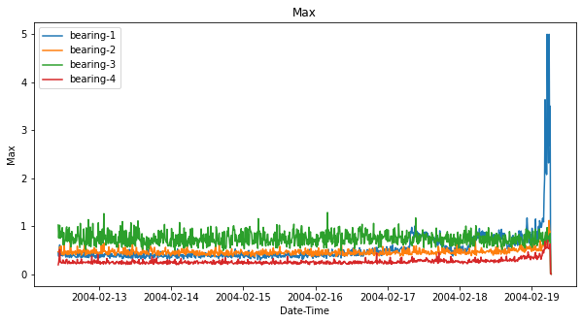
TEST-2 (Statistical analysis for min and max values)

Slide 15
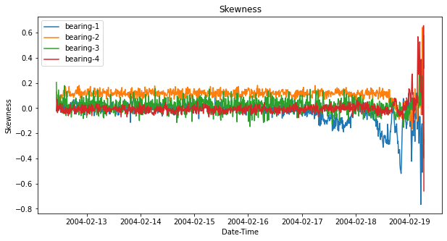
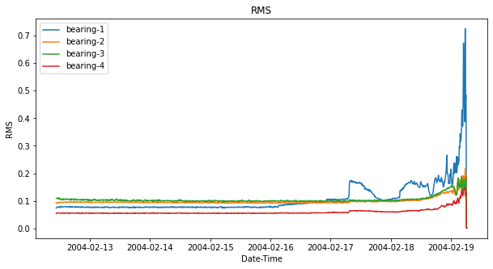
TEST-2 (Statistical analysis for skewness and rms)

Slide 16
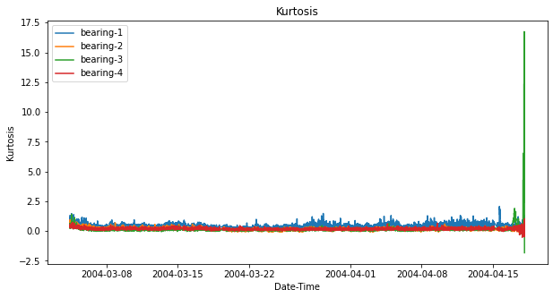
TEST-3 (Statistical analysis for Kurtosis)

Slide 17
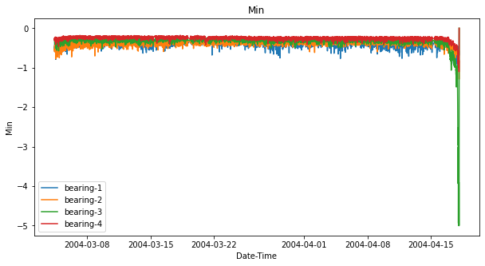
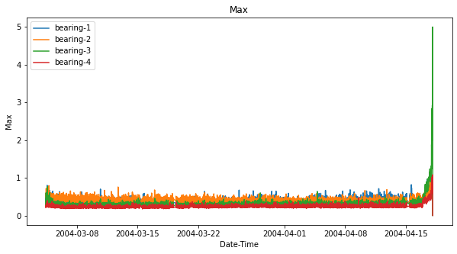
TEST-3 (Statistical analysis for min and max values)

Slide 18
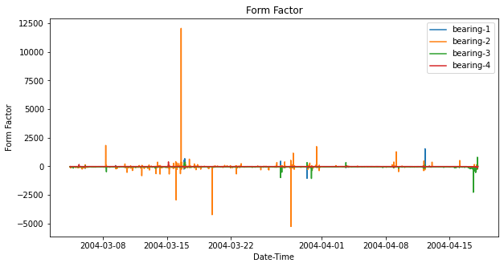
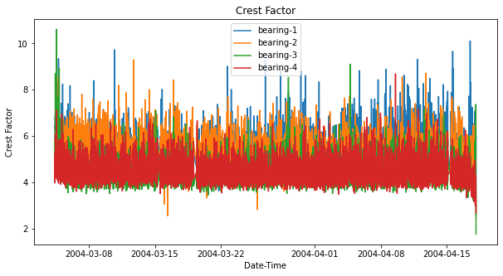
TEST-3 (Statistical analysis for Form and Crest factor)

Slide 19
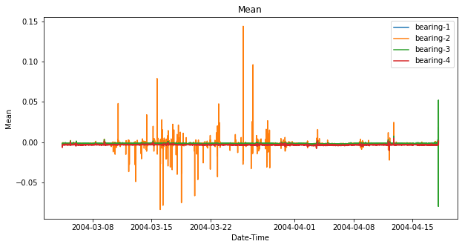
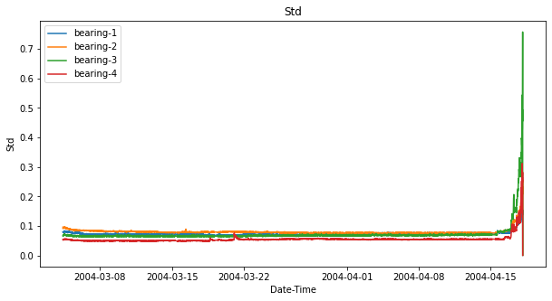
TEST-3 (Statistical analysis for mean and standard deviation)

Slide 20
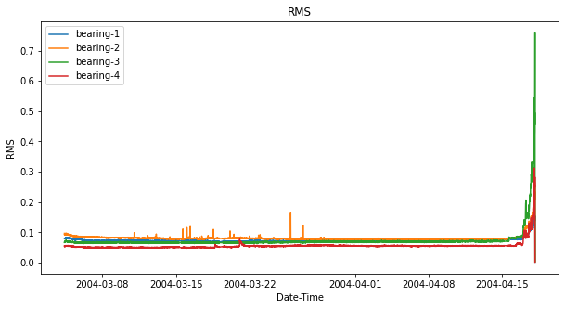
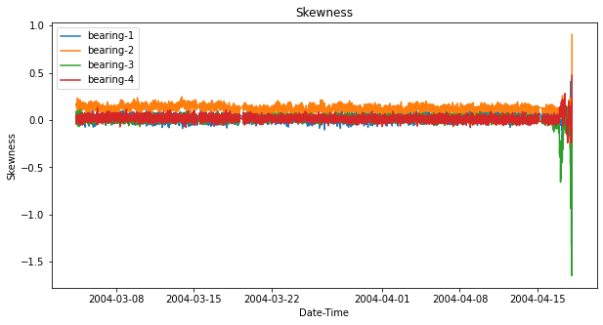
TEST-3 (Statistical analysis for rms and skewness)

Slide 21
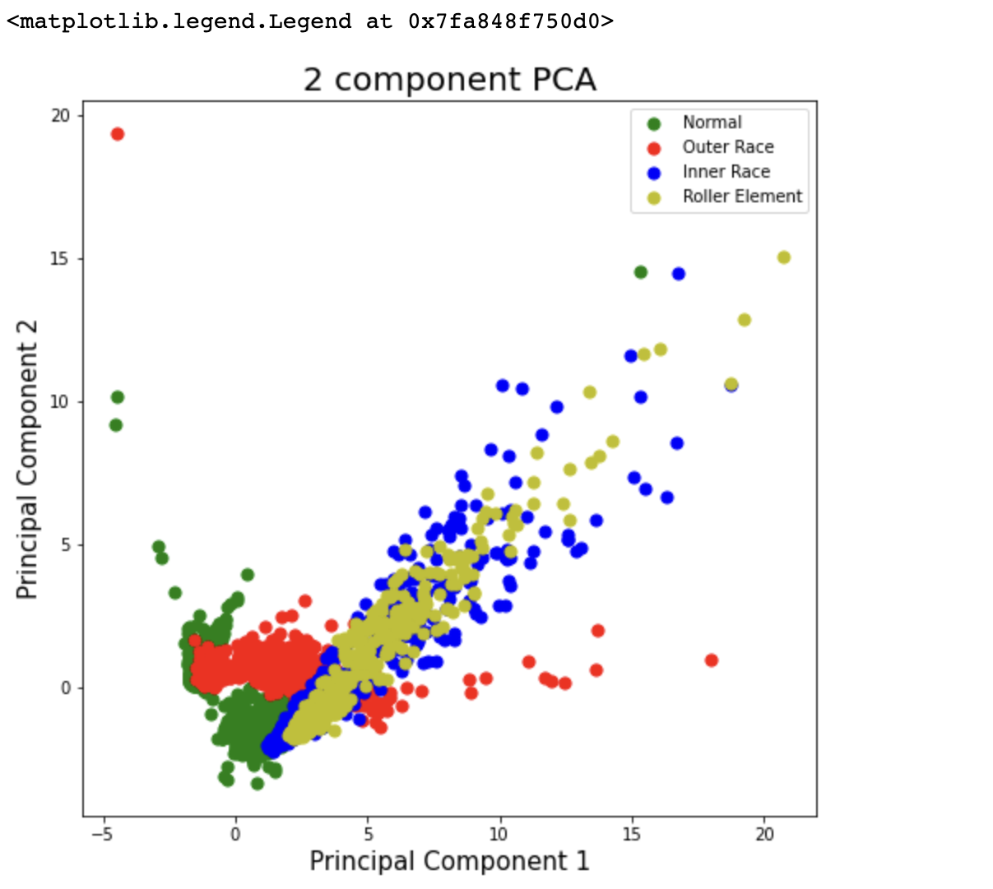
PCA VISUALIZATION IN 2D

Slide 22
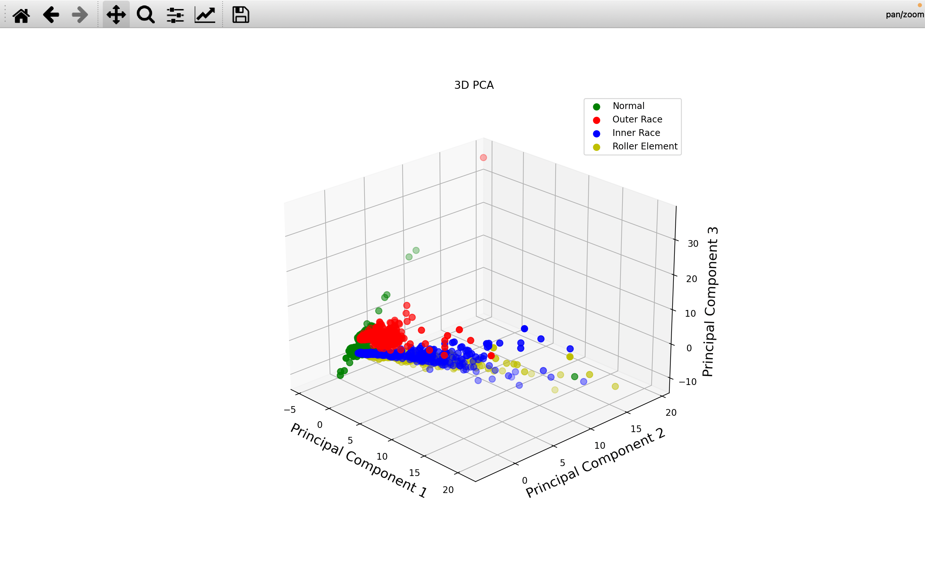
PCA VISUALIZATION IN 3D

Slide 23
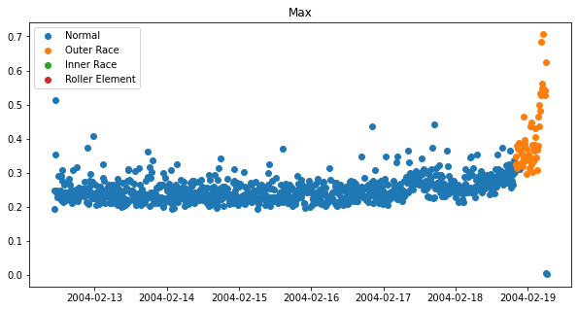
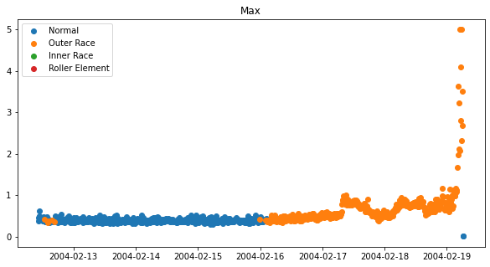
Prediction Using Random Forest
Test 2 bearing 4
Test 2 Bearing 1

Slide 24
Experimental Results
This analysis evaluates the performance of the PCA method by employing it in several run-to- failure bearing experiments. The IMS Bearing dataset contents and objective are introduced first. Then the dataset is subjected to signal processing, training, and online monitoring as per the proposed approach. The performance of PCA is illustrated in various tests, and finally, the results are benchmarked with state of the art fault detection methods applied to the IMS Bearing dataset. As drawback, these techniques require historical data, that are not available so frequently. The model-based and data-driven approaches could be combined to offer a quick diagnostics service and reliable maintenance of the algorithms

Slide 25
Links and References
Dataset link: https://www.kaggle.com/datasets/vinayak123tyagi/bearing-dataset?select=Readme+Document+for+IMS+Bearing+Data.pdf

Slide 26
ROLES AND RESPONSIBILITY
Names | Responsibilities
Anshika Aggarwal | PCA, PPT, Problem Statement
Navin Joshi | Found Dataset,Feature extraction and Visualisation(TEST-1)
Vaishnavi Sukhatme | Modelling and Prediction
Muskan Thapa | Visualisation(TEST-3)
Varun C | Visualisation(TEST-2)
Saranya M | Experimental Results and Analysis

